Slide 1

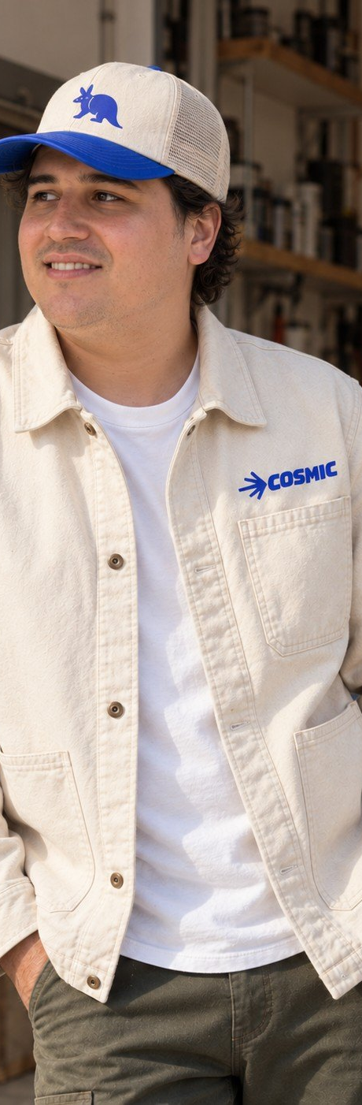


PROPERTY SERVICES. DONE PROPERLY.
Owner-led. Austin-built.
Notes:
banners/04-youtube

